Slide 1
Introduction to precision medicine and proteomics related precision medicine with diabetic nephropathy
Professor Peter Rossing MD DMSc

Slide 2
Disclosures
Professor Rossing has received the following:
  Consultancy and/or speaking fees (to his institution) from AbbVie, Astellas, AstraZeneca, Bayer, Boehringer Ingelheim, Bristol-Myers Squibb, Eli Lilly, MSD, Novo Nordisk and Sanofi Aventis
  Research grants from AbbVie, AstraZeneca and Novo Nordisk

Slide 3
Diabetes is the leading cause of kidney failure
US DATA
60,000
50,000
Diabetes
40,000
Number of patients
Hypertension
30,000
20,000
10,000
Glomerulonephritis
Cystic kidney
0
1980
1985
1990
1995
2000
2005
2010
Year
United States Renal Data System. 2018 USRDS annual data report: Epidemiology of kidney disease in the United States. National Institutes of Health, National Institute of Diabetes and Digestive and Kidney Diseases, Bethesda, MD, 2018.

Slide 4
DKD: A growing disease population with a complex prognosis
2017
Prognosis of patient with T2D and dialysis
425 million people
Prostate cancer
One in 11 adults had diabetes
Thyroid cancer
Breast cancer
Hodgkin lymphoma
48% increase
Bladder cancer
Non-Hodgkin lymphoma
Kidney cancer
Colorectal cancer
Leukemia
Long-term dialysis
Myeloma
Dialysis + T2D*
Heart failure
Stomach cancer
2045
Esophageal cancer
629 million people
will have diabetes
Lung cancer
Pancreatic cancer
0
20
40
60
80
100
% 5 year survival
The age group 65–79 years shows the highest diabetes prevalence in both women and men.
DKD, diabetic kidney disease.
International Diabetes Federation. IDF Diabetes Atlas. 8th edn. Brussels, Belgium: International Diabetes Federation, 2017.
Available at: http://www.diabetesatlas.org Accessed 12 April 2019.

Slide 5
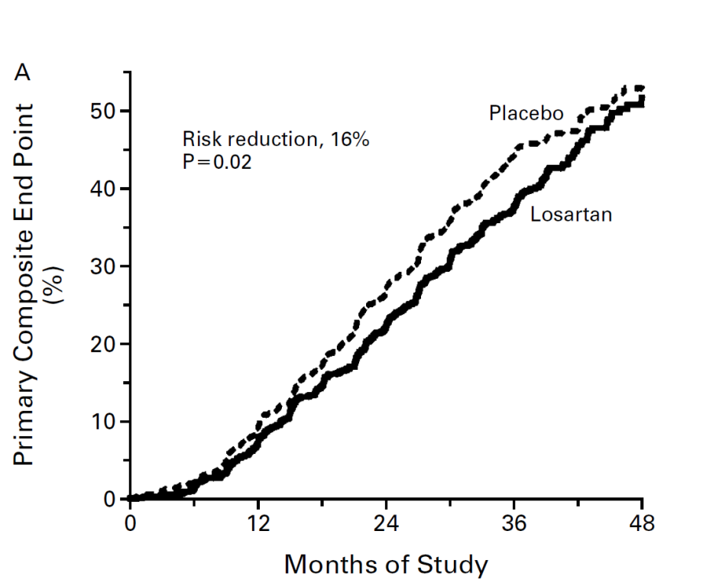
RENAAL: effects of Losartan on renal function and CVD in type 2 diabetes and nephropathy
The unmet need
CVD, cardiovascular disease; RENAAL, Reduction of Endpoints in NIDDM with the Angiotensin II Antagonist Losartan
Brenner et al. New Eng J Med 2001;345:861–9

Slide 6
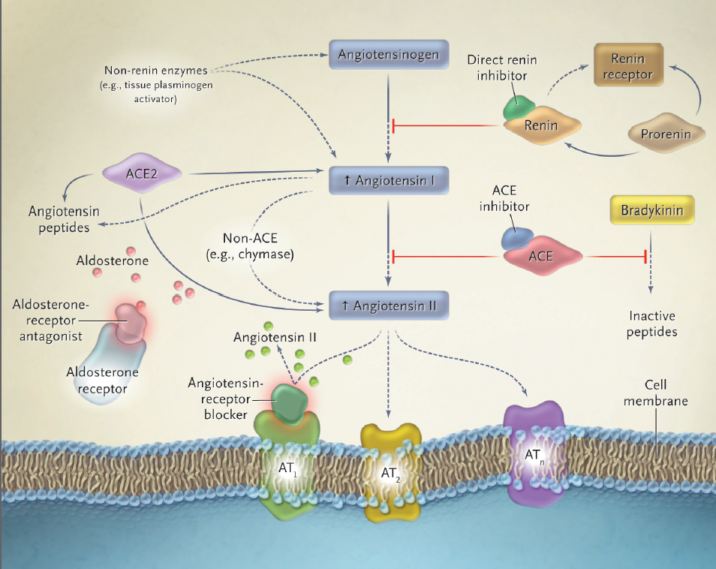
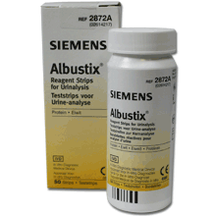
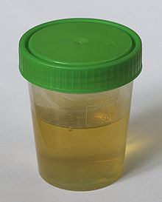
Proteinuria based prevention of DM nephropathy
Albuminuria RAS-inhibition

Slide 7
Natural history of DN
GFR
Urinary protein excretion
Pre
Incipient diabetic
nephropathy
Overt diabetic
nephropathy
End-stage
renal disease
1
2
3
4
5
150
5000
Glomerular filtration rate (GFR) (mL/min)
1000
100
Urinary protein excretion (mg/d)
50
200
20
0
5
10
15
Years
20
25
Functional | GFR ­ (90-95%) | Microalbuminuria, hypertension | Proteinuria, nephrotic syndrome, GFR ¯
Structural | Renal hypertrophy | Mesangial expansion, glomerular basement membrane thickening, arteriolar hyalinosis | Mesangial nodules (Kimmelstiel-Wilson lesions) Tubular-interstitial fibrosis
Vora JP, et al. In: Johnson RJ, Feehally J, eds. Comprehensive Clinical Nephrology, 2000.
Notes:
This slide illustrates the natural history of diabetic nephropathy from the time of diabetes onset, characterised by changes in glomerular filtration rate (GRF) and proteinuria and structural changes in the kidney¹
Glomerular hypoperfusion occurs in the first years after diabetes onset (particularly in type 1 diabetes), accompanied by renal hypertrophy and an increase in GFR²
Basement membrane thickening takes place around 5 years after diabetes onset; at the same time mesangial volume is increased, while GFR returns to normal values²
After 5-10 years, nearly 40% of the people start to exhibit microalbuminuria (incipient nephropathy). Arterial pressure may also be increased²
Once proteinuria appears, GFR progressively decreases (overt diabetic nephropathy) and irreversible pathological changes begin to occur²
Half of all cases of end-stage renal disease take place around 7 to 10 years after proteinuria onset²
Reference
Vora JP, et al. Clinical manifestations and natural history of diabetic nephropathy. In: Johnson RJ, Feehally J, eds. Comprehensive Clinical Nephrology. New York: Mosby; 2000.
Blézquez-Medela AM, et al. Mechanisms involved in the genesis of diabetic nephropathy. Curr Diabetes Rev. 2010;6(2):68-87.
6

Slide 8
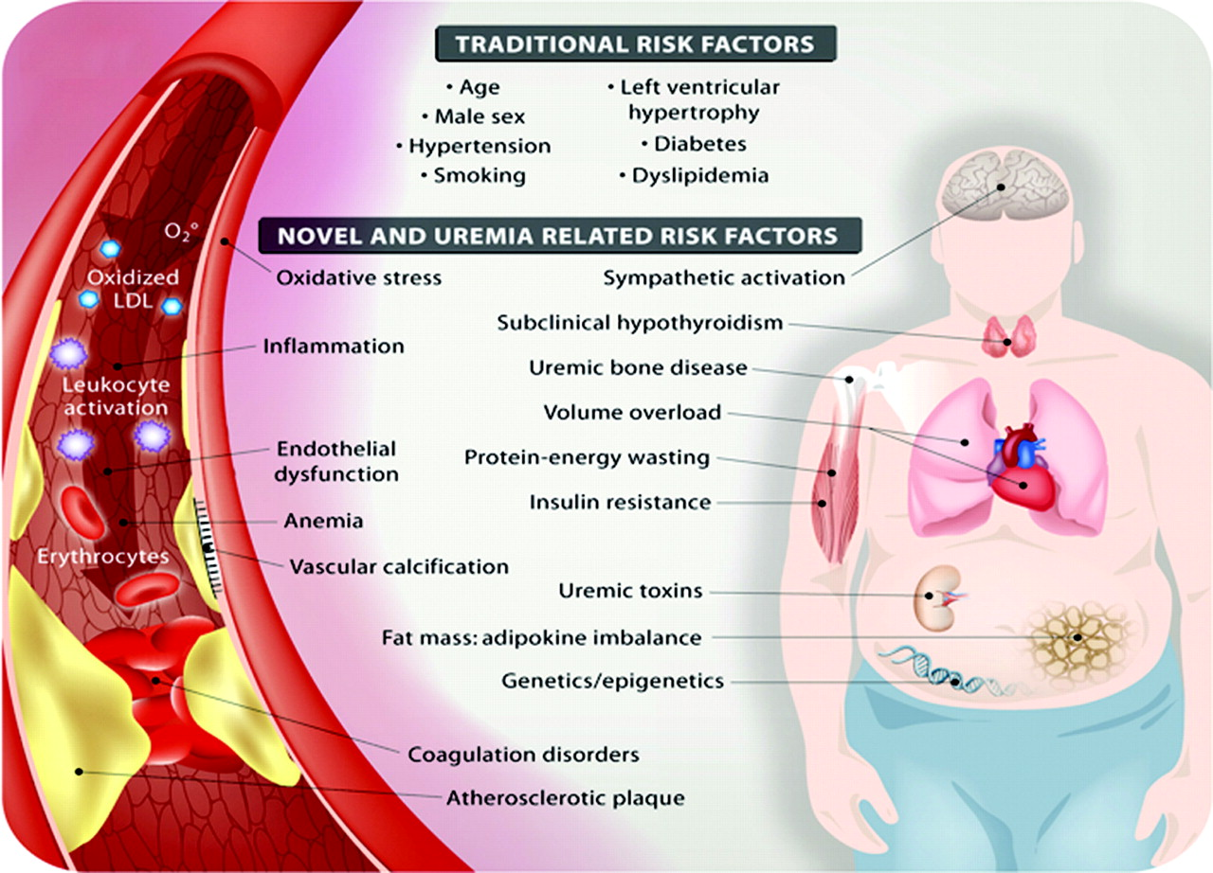
Hypothesis driven search for biomarkers
Copyright ©2008 American Society of Nephrology

Slide 9
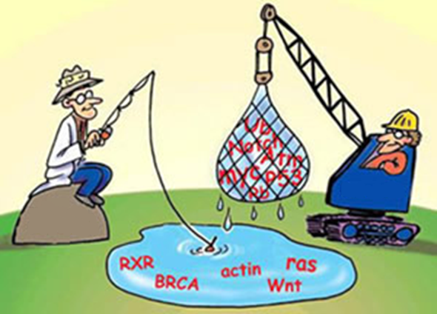
Unbiased (open) search for new markers
Proteomics
Single marker
strategy

Slide 10
Proteomics
Proteome: All proteins synthesized by a particular cell (at a particular time)
Proteomics: The analysis of the expression, localizations, functions, and interactions of proteomes

Slide 11
H Lambers Heerspink et al 2016

Slide 12
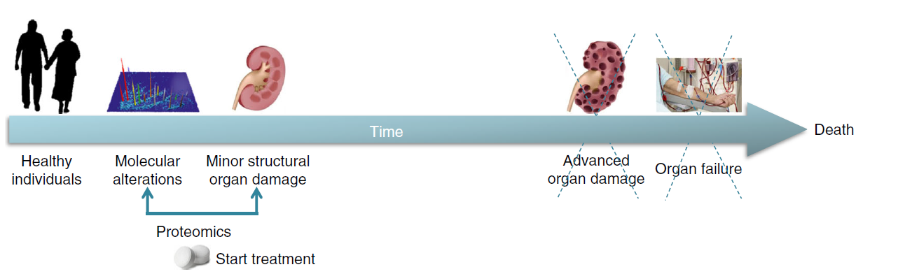
H Lambers Heerspink et al 2016

Slide 13
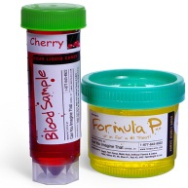
Proteomic utility in DN
    Add to our understanding of patho-physiology
    Identify patients at risk
    Monitor progression of disease and treatment efficacy
    May identify new treatment targets

Slide 14
KRIS: A signature of circulating inflammatory proteins and development of end-stage renal disease in diabetes
Chronic inflammation is postulated to be involved in the development of end-stage renal disease in diabetes, but which specific circulating inflammatory proteins contribute to this risk remain unknown.
To study this, 194 circulating inflammatory proteins in subjects from three independent cohorts with type 1 and type 2 diabetes were examined .
A robust Kidney Risk Inflammatory Signature (KRIS), consisting of 17 proteins enriched in tumor necrosis factor-receptor superfamily members, was identified
M Niewczas et al, Nature Medicine, Vol 25; MAY 2019; 805–813

Slide 15
KRIS: A signature of circulating inflammatory proteins and development of end-stage renal disease in diabetes
M Niewczas et al, Nature Medicine, Vol 25; MAY 2019; 805–813

Slide 16
A signature of circulating inflammatory proteins and development of end-stage renal disease in diabetes
KRIS response to:
A Losartan
B Baricitinip
M Niewczas et al, Nature Medicine, Vol 25; MAY 2019; 805–813

Slide 17
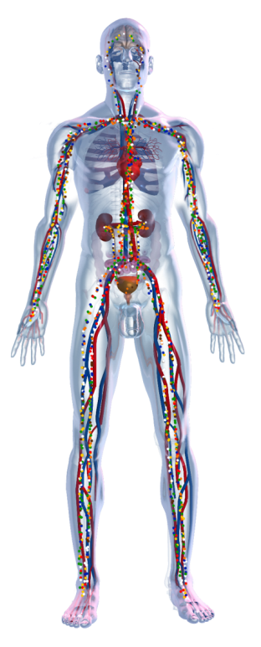
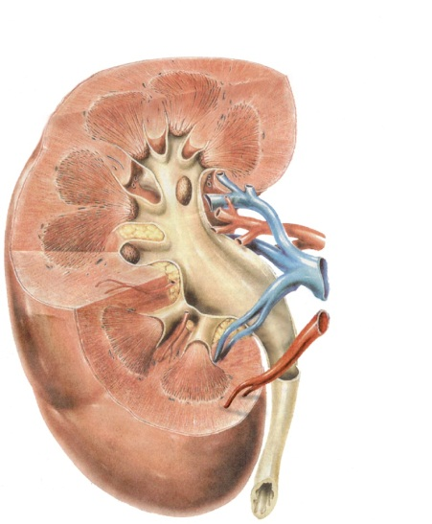

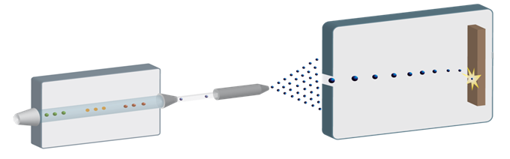

CE-MS proteomic technique -
High separation power and sensitive detection
Separation and analysis
of proteins and peptides
(>1,000)
Run time ~60 min
CE
fast
robust
inexpensive
reproducible
MS
resolution
scan speed
Urine sample
Mass spectrometry
Data evaluation
Capillary
electrophoresis

Slide 18
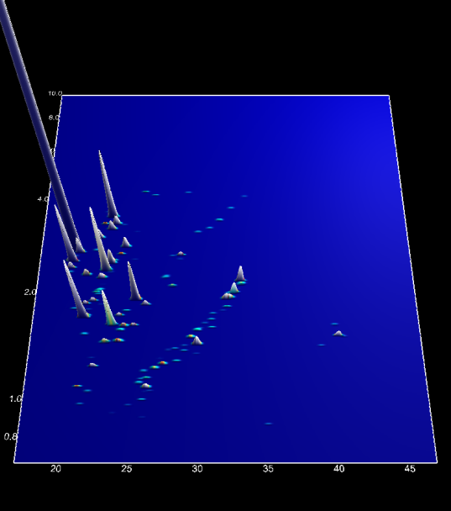
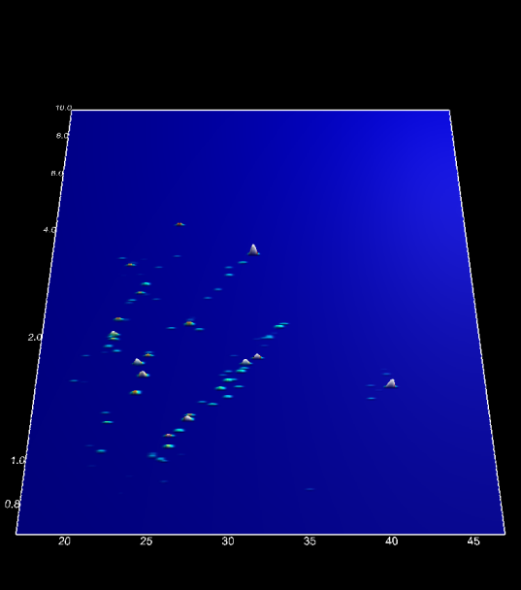
Proteomic CKD biomarker discovery
CKD
HC
CKD pattern (n=273 biomarker):
different collagens
plasma proteins (serum albumin, transthyretin, alpha-1-antitrypsin, alpha- 1B-glycoprotein, alpha-2-HS-glycoprotein, antithrombin-III, apolipoprotein A-I, beta-2-microglobulin, fibrinogen alpha)
clusterin
uromodulin
sodium/potassium-transporting ATPase gamma chain
psoriasis susceptibility 1 candidate gene 2 protein
prostaglandin-H2 D-isomerase
proprotein convertase subtilisin/kexin type 1 inhibitor
polymeric-immunoglobulin receptor
osteopontin
neurosecretory protein VGF
Membrane associated progesterone receptor component 1
CD99 antigen
Ig lambda chain C regions
Mass [kDa]
CE migration time [min]
CE migration time [min]
Training set
CASE | CONTROL
Σ: 230 30 ANCA, 30 MGN, 22 MCD, 44 IgAN, 25 FSGS, 58 DN, 21 SLE | Σ: 379 379 HC

Slide 19
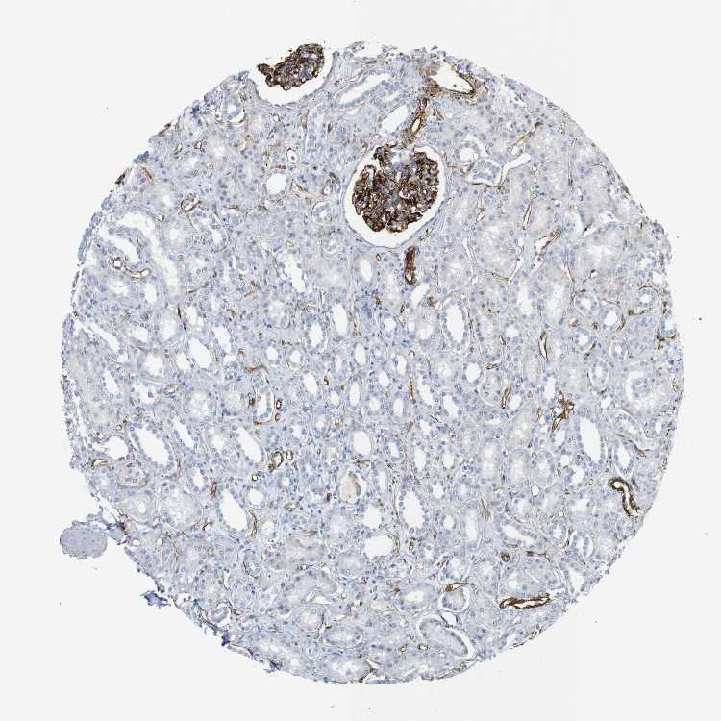
CKD-biomarkers and their regulation
STRUCTURAL (ECM) PROTEINS
Collagen:
specific fragments decreased in urine of CKD patients
function: main proteins of connective tissue (~30% of whole-body protein content)
cellular component: extracellular matrix; secreted
expressed in glomeruli and renal tubulointerstitial regions
products of (myo)fibroblasts, degraded by MMPs
glomerulus
Collagen alpha-1 (I)
© 2010 www.proteinatlas.org

Slide 20
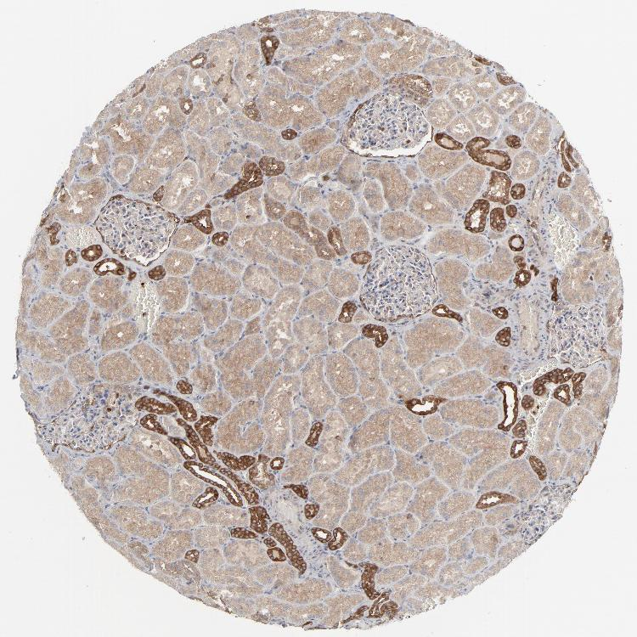
Apoptosis related proteins
  Osteopontin:
expressed in renal tubules and in mineralized tissues
remodeling of extracellular matrix
inhibition of apoptosis
  Clusterin/Apolipoprotein J:
decreased in urine of CKD patients
subcellular location: secreted
remodeling of extracellular matrix
correlated inversely with proteinuria in CKD patients
associated with apoptosis
tubulus
Osteopontin
© 2010 www.proteinatlas.org
Clusterin
Takase at al., Kidney Intern. 2008

Slide 21
Pathosphysiological suggestions
Apoptosis/chronic inflammation (ROS, AGE)
Acute phase response
Inhibition of matrix metalloproteases (e.g. MMP2 and MMP9)
u-A1AT ↑
Inhibition of plasmin
Increased collagen accumulation
Reduced degradation of collagens
Excessive accumulation of ECM
u-Collagens↓
Inhibition of fibrinolysis
u-FIBA ↓
Renal fibrosis
Glomerular fibrin deposition
u-B2MG ↑
u-ALBU ↑
Reducted renal function / proteinuria
Renal damage
u-Plasma
proteins ↑
Decrease of GFR

Slide 22
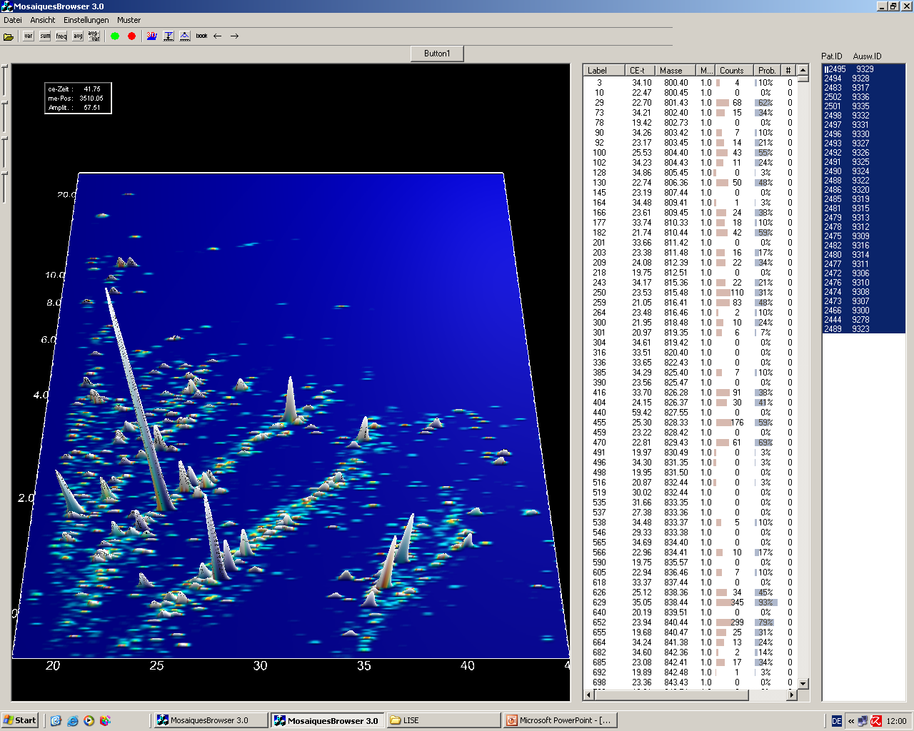
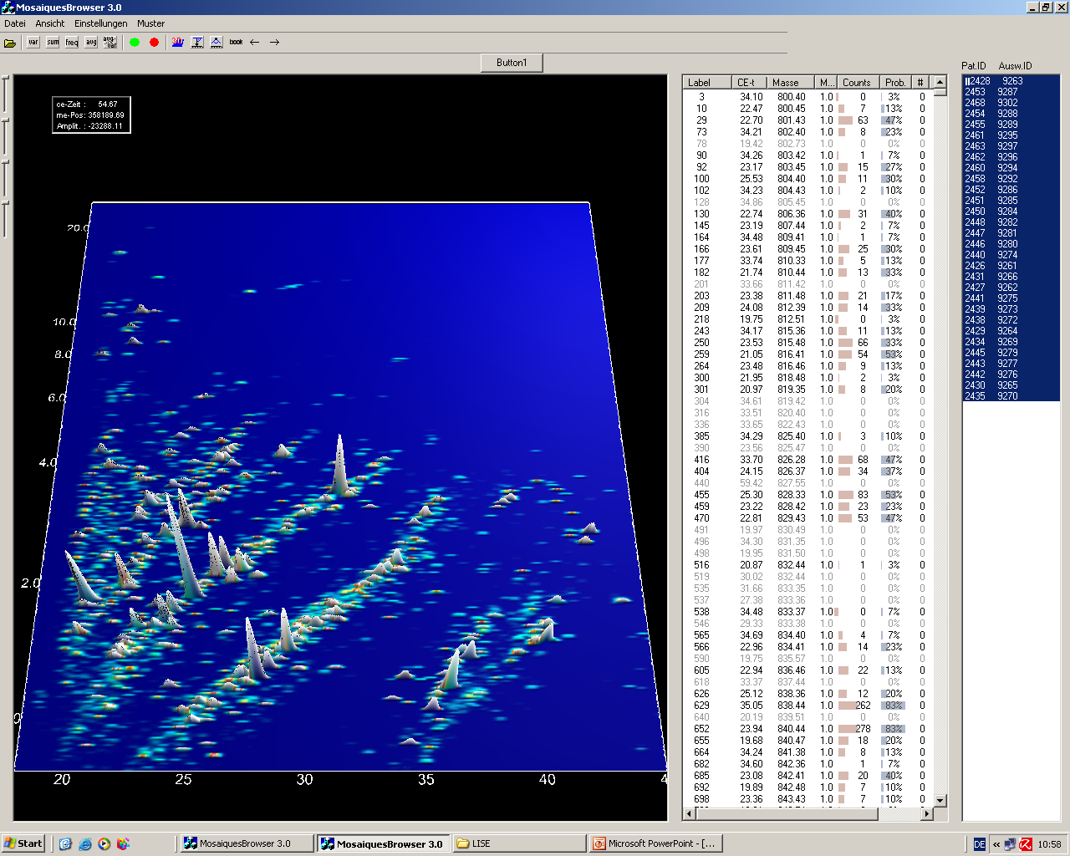
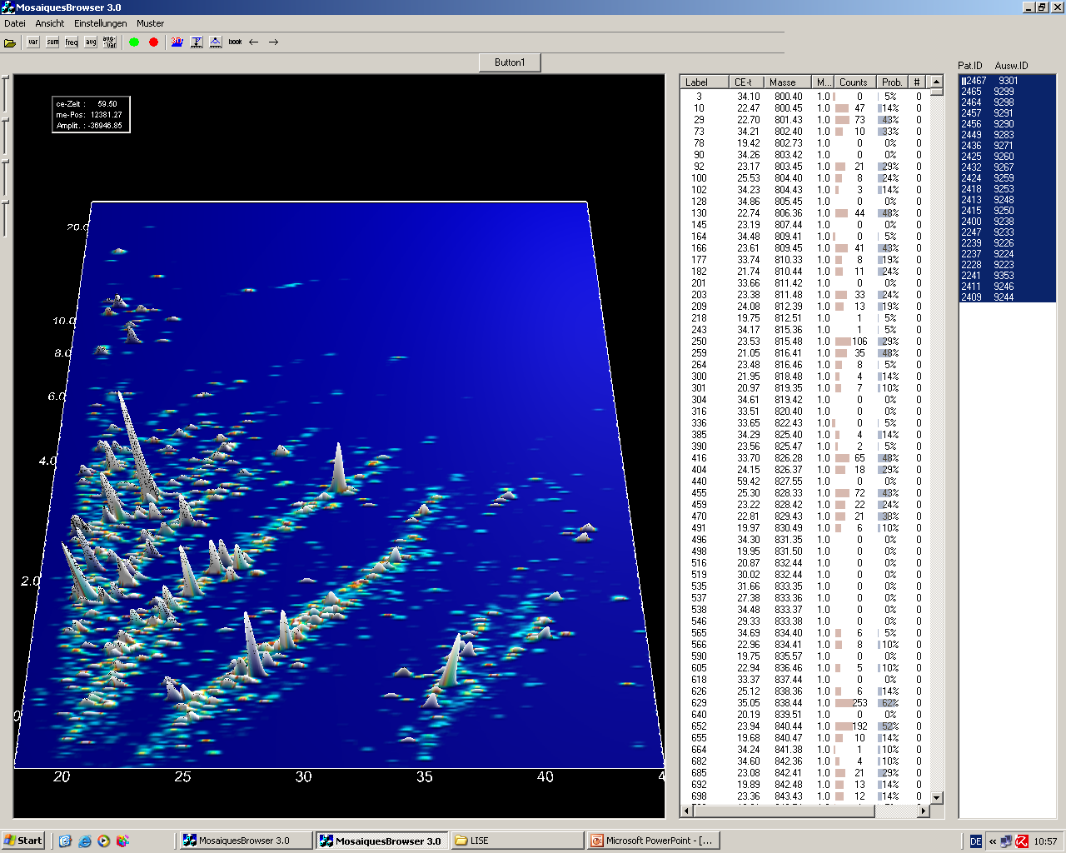
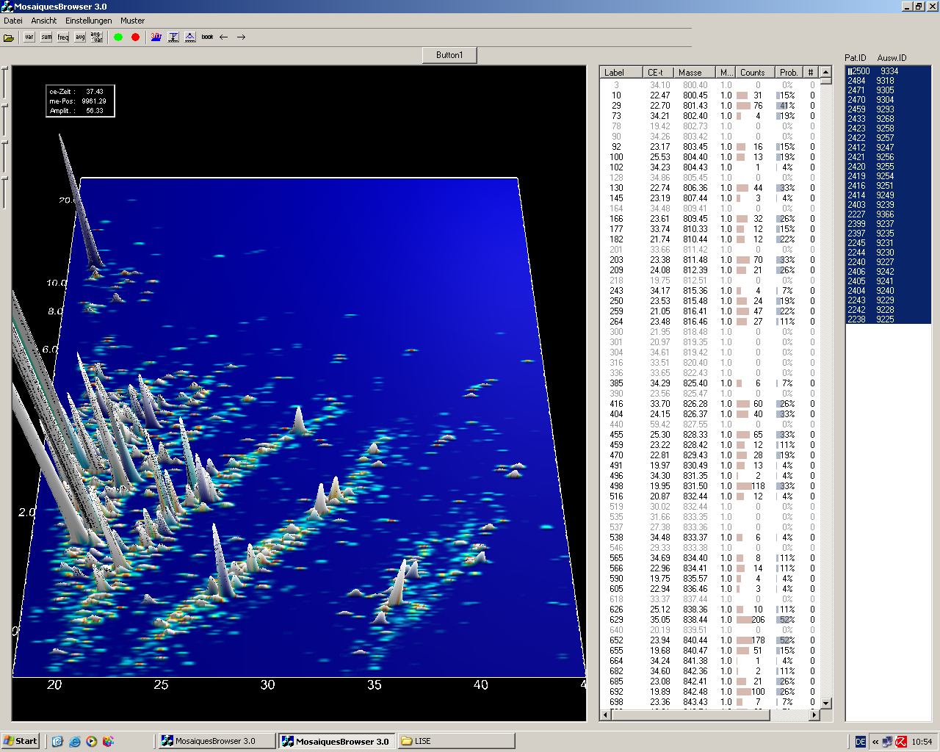
Proteomic profile: T1DM +/- DN
Control
Normo
Micro
Macro

Slide 23
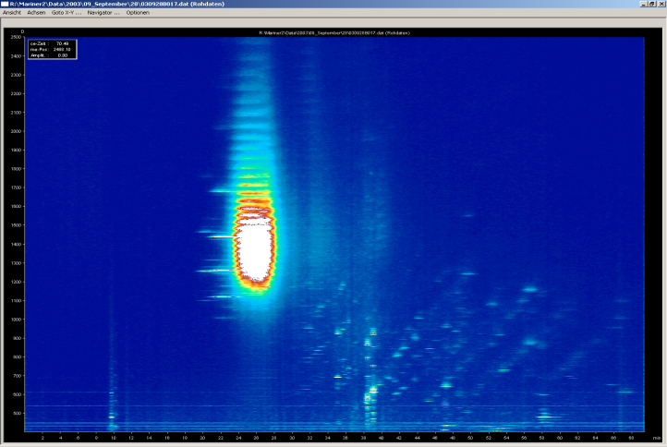
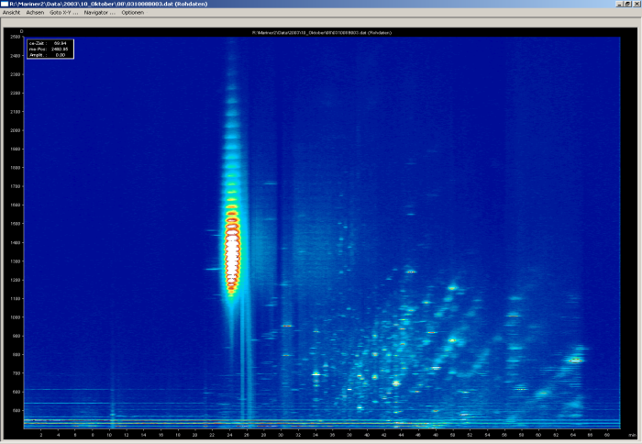
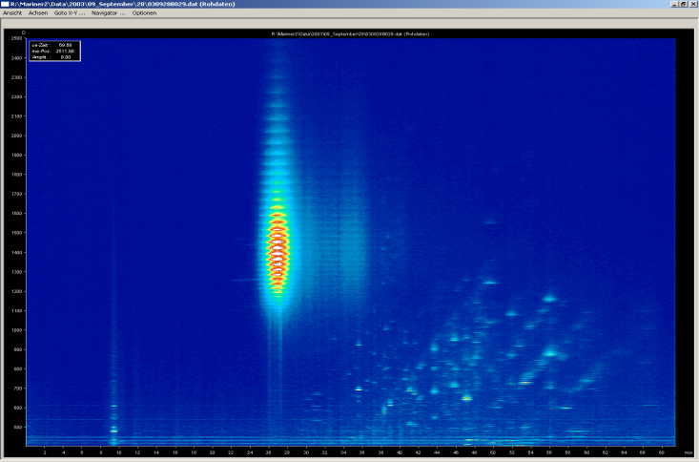
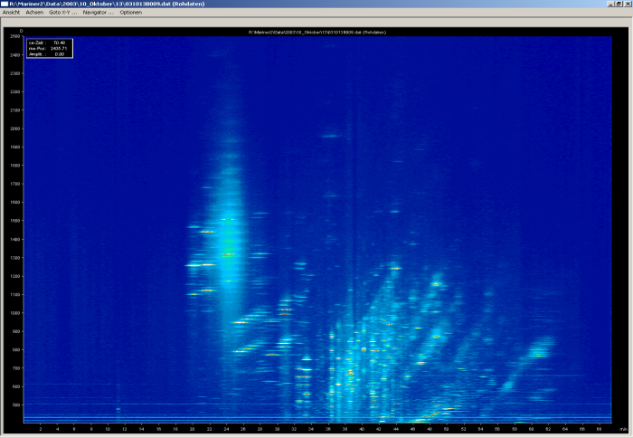
Monitoring Treatment Efficacy: Candesartan in T2DM and DN
0 mg
8 mg
16 mg
32 mg
Notes:
22

Slide 24
Prediction
Longitudinal analysis of non-progressors and progressors to DN
Proteome analysis and AER from diabetic normoalbuminuric patients (151 samples), assessed for progression to DN over 5 years
 | AUC | 95% CI
AER [µg/min] | 0.648 | 0.566 to 0.724
CKD model | 0.887 | 0.826 to 0.933
Zürbig et al Diabetes 2012

Slide 25
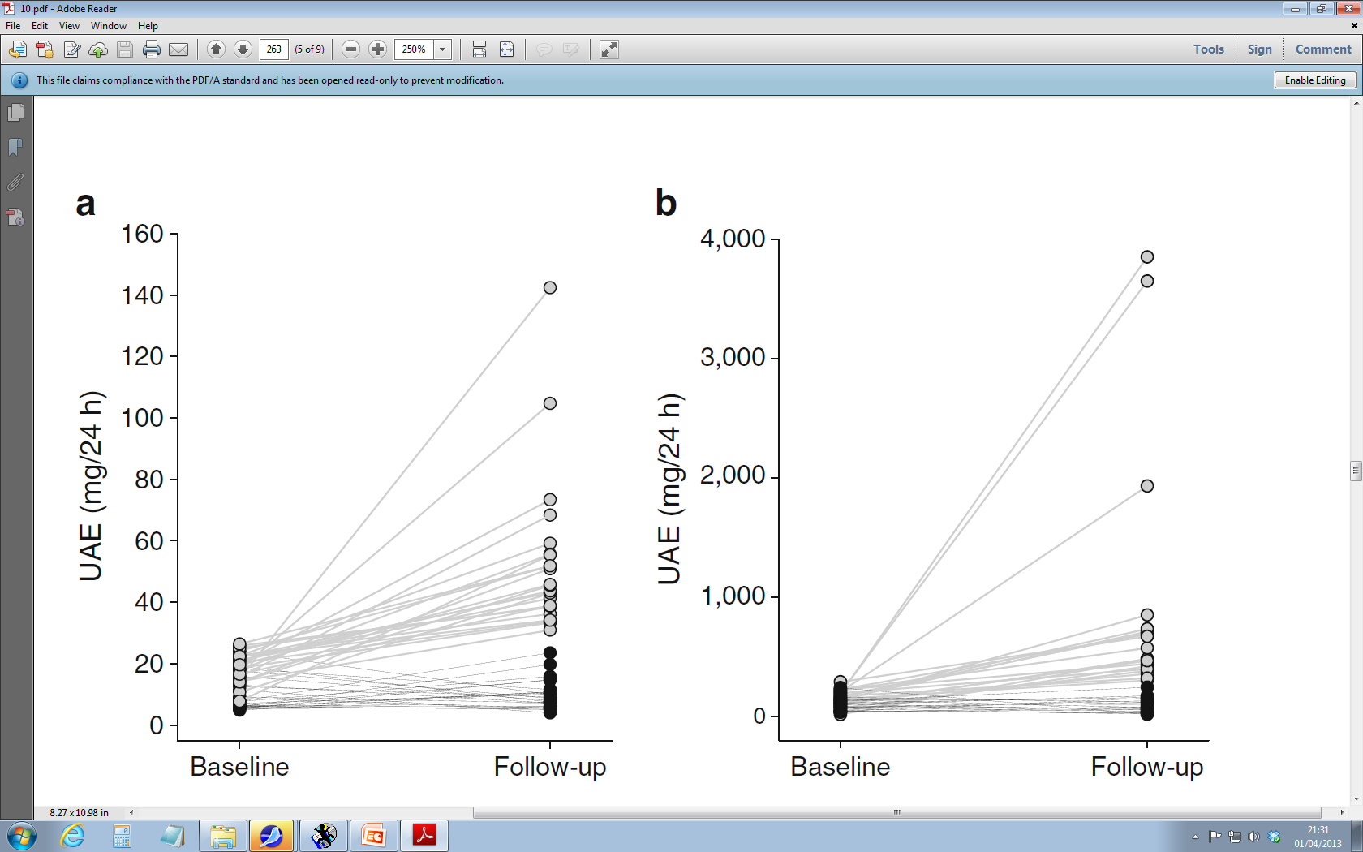
Prediction of Diabetic Nephropathy
Normo → Micro
Micro → Macro
Roscioni SS et al. Diabetologia 2013

Slide 26
Direct 2 (n=1905)
To confirm the abilities of the CKD 273 classifier to predict development of microalbuminuria, in a large diabetic cohort with normoalbuminuria.
v
Inclusion criteria e.g.
Type 2 DM
Normoalbuminuric
Normotensive (67% in treatment at baseline)
Exclusion criteria e.g.
Need of RAAS blocking agents
Proliferative retinopathy
Lindhardt, NDT 2016

Slide 27
Direct 2
  Cox regression model
    CKD273: HR 2.6 (95% CI 1.6 – 4.4), p = 0.0002
    Adjusted CKD273: HR 2.5 (95% CI 1.4 – 4.3), p = 0.002 Adjusted for: UAER, eGFR, HDL, Age, Systolic BP, HbA_{1c}, Smoking, Gender, Antihypertensive treatment.
  Comparison
    rIDI: 14.4%, p = 0.002
    cNRI: 0.1, p = 0.043
Lindhardt et al, NDT 2016

Slide 28
CKD273 predicts decline in eGFR
JP Schanstra et al JASN 2015

Slide 29

Proteinuria based prevention of DM nephropathy
Albuminuria RAS-inhibition

Slide 30

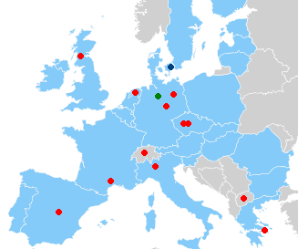
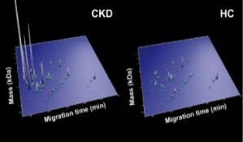
The Priority Trial
Type 2 DM
Normoalbuminuria
Randomised
Double-blinded
Placebo controlled
Observational
High-risk
n ~ 250
Low-risk
n ~ 1700
Proteomic test
Placebo
Spironolactone
Three years follow-up
Ending 2018

Slide 31
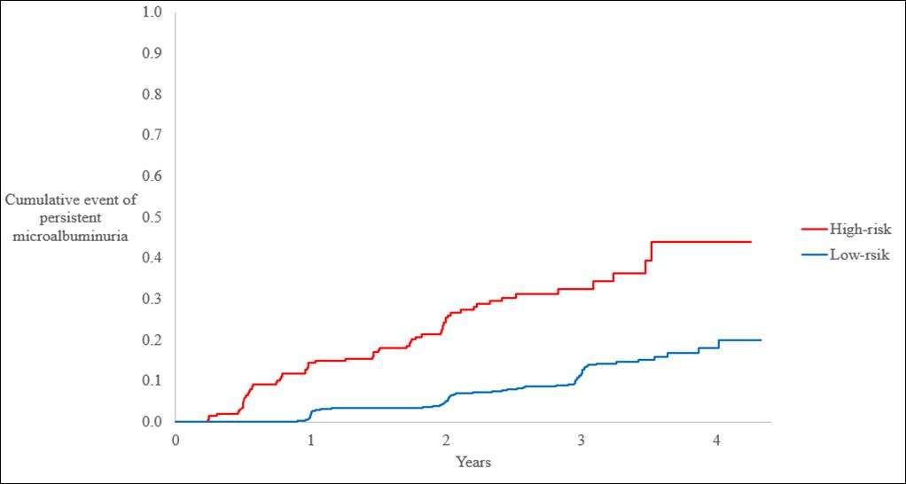
Persistent microalbuminuria high-risk vs low risk
Adjusted cox model, p=<0.0001
HR low vs. high risk 2.48 (95% CI 1.796-3.424), p=<0.0001
(Adjusted for age, gender, HbA1c, SBP, retinopathy, eGFR and UACR)

Slide 32
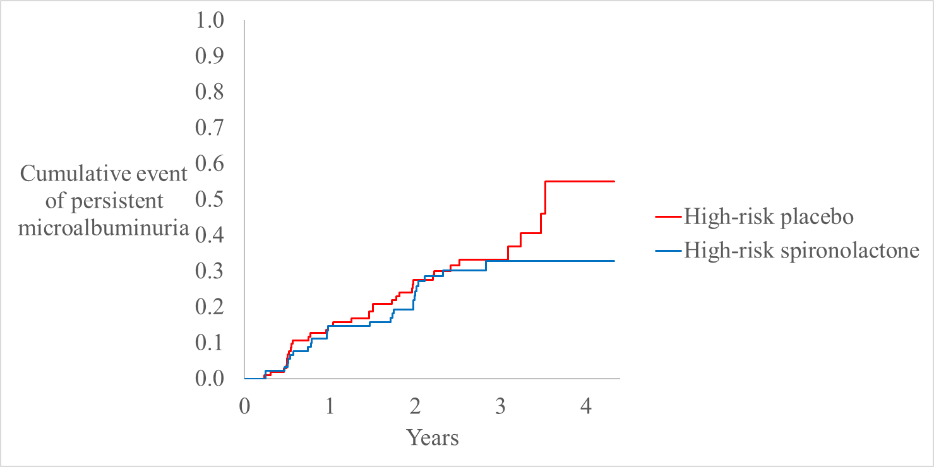
Spironolactone or placebo in high-risk individuals
Hazard Ratio
0.81, 95% CI, 0.49 to 1.34,
P = 0.41

Slide 33


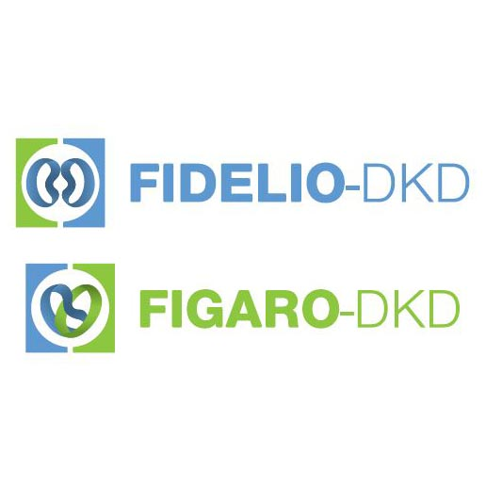

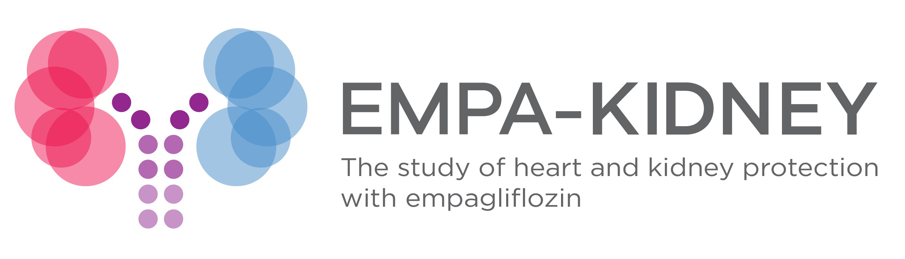

Renal trials in type 2 DM
Could SGLT2i, GLP1 RA or non-steroidal MRA be alternative interventions?
CKD, chronic kidney disease; SGLT2, sodium/glucose cotransporter 2

Slide 34
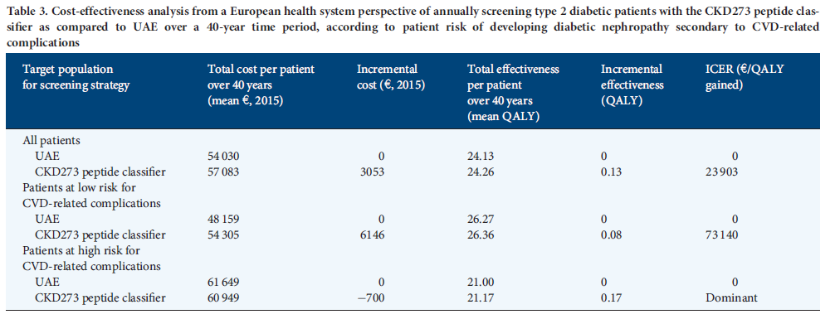
Cost effectiveness of urinary proteomics: depends on baseline risk
high risk T2DM patients with at least one concomitant risk factor (i.e. patients with background genetic risk for developing the disease, obesity, hypertension and/or smoking history) for developing diabetic nephropathy secondary to cardiovascular disease (CVD)-related complications)
E Critselis et al NDT 2018

Slide 35

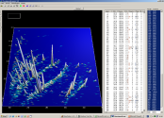


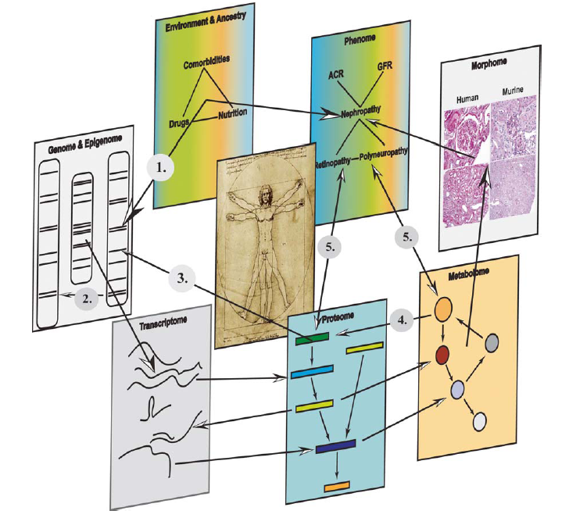
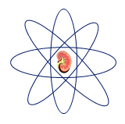
Personalised treatment in the future
n ~ ?
Randomised
Double-blinded
Placebo controlled
High-risk profile
Observational
Low-risk
Omics
Targeted
intervention
follow-up

Slide 36
Conclusions
Proteomics provide biomarkers or panels based on open search
Proteomic markers enable (early) detection, prognosis, and assessment of therapy response
Biomarkers and biomarker panels could be validated in independent multi-centric blinded studies.
Variability in single biomarkers is counteracted by diagnostic patterns that tolerate instability and inconsistency of individual polypeptides/biomarkers
Urinary peptides to a large degree display and enable assessment of (patho)physiological alterations in turnover of extracellular matrix

Slide 37
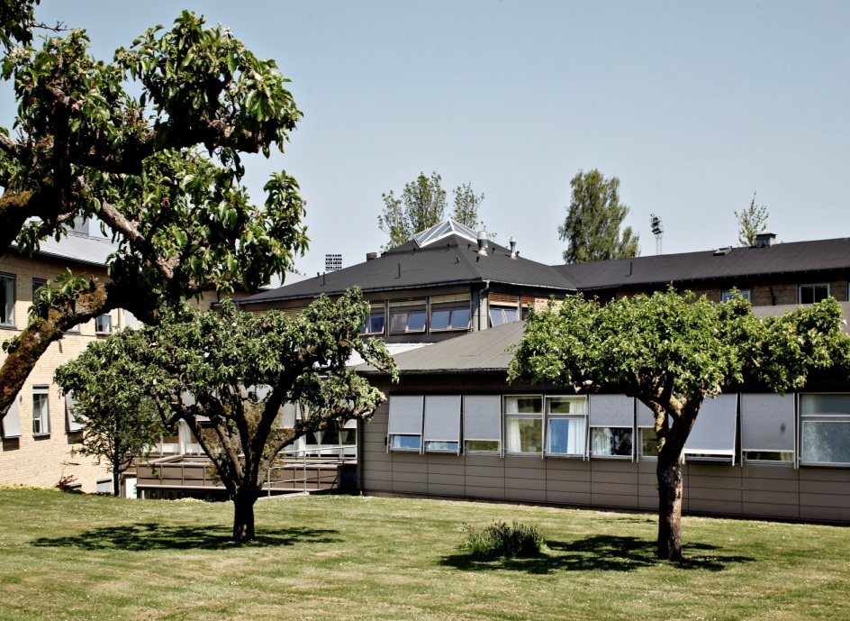
Thank you

